Slide 1

CALL VOLUME TREND ANALYSIS
MARIYA SHAJI

Slide 2


Contents
01
05
Introduction
Findings and Results
02
06
Data Cleaning
Key Takeaways
03
07
Approach and Insights
Conclusion
04
Tools and Methodology

Slide 3


Introduction
This project analyzes 23 days of inbound call data from ABC Insurance. The dataset includes call times, durations, agent details, and call status (answered, abandoned, or transferred).
The objective is to reduce the call abandonment rate from 30% to 10% by improving agent shift allocation and night coverage.
Why this matters: When too few agents are available, customers wait longer and often hang up.
Too many agents, on the other hand, increase operational costs.
This project aims to strike the right balance between service quality and cost efficiency.

Slide 4


Data Cleaning
Missing Agent Details: Replaced blanks with “Not Applicable” and ensured both name and ID are consistent.
Call Status Validation: Added a logic column: if Call duration>0 → Answered, else Abandoned.
Date-Time Features: Created a Weekday Name column to identify daily and weekly call trends.
Phone Number Checks: Validated 10-digit formats and flagged invalid entries.
Wrap-Up Status: Standardized wrap values — e.g., “Abandon not done” where missing.

Slide 5

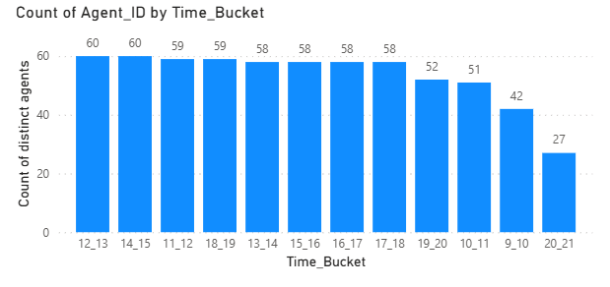
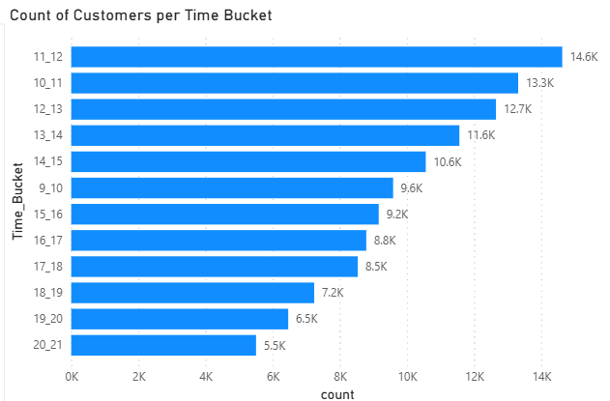
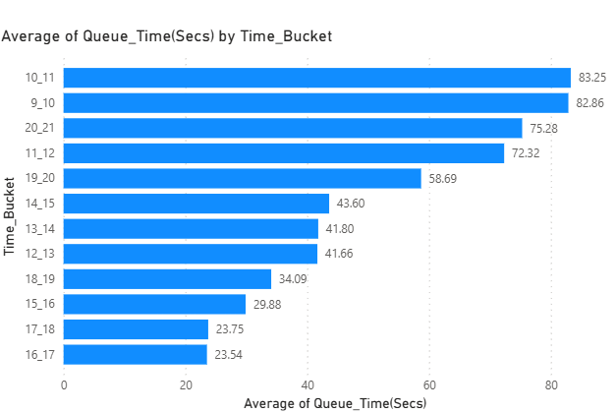
Approach and Insights
Agent Count per Time Bucket
Agent dips at 9–10 & 20–21 → staffing gap drives queues..
Count of Customers per Time Bucket
11-12 bucket has the largest number of customers to handle suggesting busy hours
Average Queue Time
Highest in mentioned time buckets driven by the largest customer volume.

Slide 6
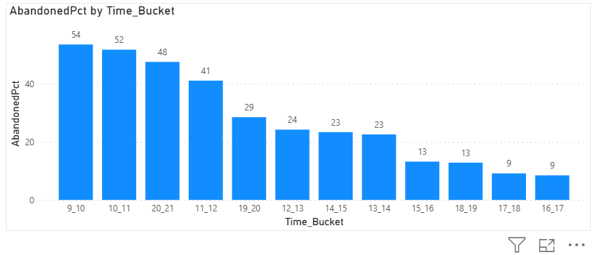
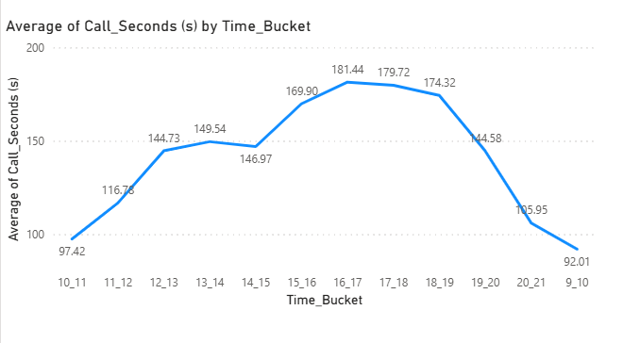
Approach and Insights
Abandon % per Bucket
Peaks in same 5 buckets matches with either low agent count or high call load.
Average Call Duration
Lowest in the same 5 buckets.
Indicates rushed conversations due to high pressure.
Together, the charts show that staff shortages and peak demand hours directly cause longer queues, higher abandonment, and shorter call durations.

Slide 7
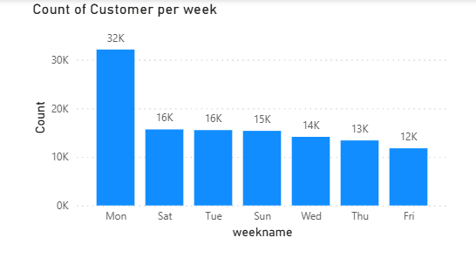
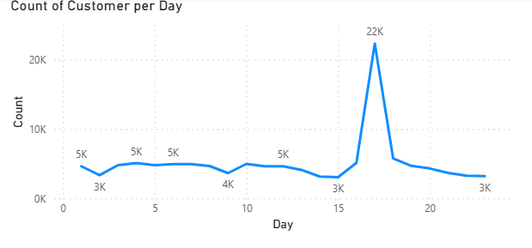
Approach and Insights
Daily & Weekly Call Volume Insights
Calls per Day
Normally between 3,000 – 5,500 calls/day.
On 17th, volume spiked to 22,000 calls, suggesting a system/data issue or unusual customer surge.
Calls by Weekday
Highest on Mondays → likely backlog from the weekend.
Lowest on Fridays → lighter customer activity
These patterns help in detecting anomalies (like 17th) and planning weekly staffing levels.

Slide 8
Approach and Insights
Manpower Planning Table (Max Required)
Reduce abandoned call rate from ~30% to ≤10% (equivalent to 90% answered) by optimizing agents per time bucket using Power BI & DAX.
Key Assumptions
Parameter | Value | Description
Working Days/Week | 6 | Agents work 6 days weekly
Unplanned Leaves/Month | 4 | Adjusted from total
Average Working Days in Dataset | 17 (out of 23 days) | Based on 6-day schedule & leave assumption
Shift Length | 9 hours/day | Including breaks
Lunch & Admin Time | 1.5 hours | Non-call productive time
Actual Productive Hours | 7.5 hrs/day | Real working hours
% Time on Calls | 60% | Company policy (active handling)
Expected Talk Time | ≈4.5 hrs/day | 7.5 × 0.6

Slide 9
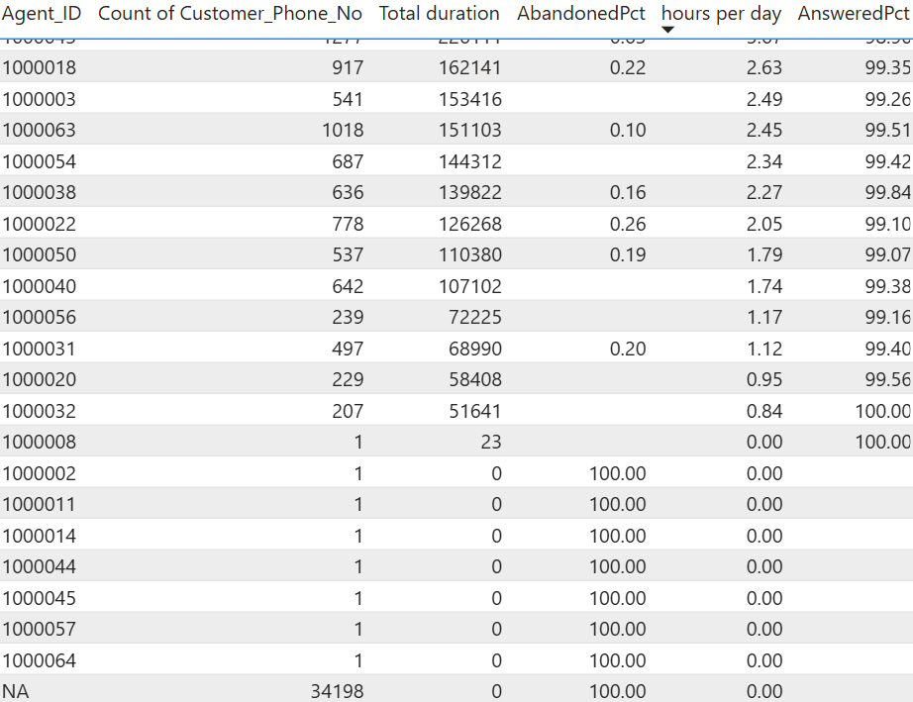
Approach and Insights

Slide 10
Approach and Insights
Important Checks Before Adding Agents
Agent Efficiency
Some agents work <4 hours/day → need training or better workload distribution.
Others work >7 hours/day → highly productive; could reduce need for new hires.
Inactive / 0-Hour Agents
A few show 0 working hours but still linked to calls → likely inactive/off-boarded.
Their calls inflate abandon %; verify and exclude them from routing/data joins.
Abandoned Calls (No Agent ID)
29.22% total abandon → ~29% system-related, not agent fault.
Causes: IVR/routing drops, timeouts, inactive IDs, data-mapping errors.
Agent abandon = only 0.24% → core issue = process inefficiency, not manpower.
Recommendation
Fix routing & mapping → remove inactive agents, repair data joins.
Redistribute workload → balance under/overutilized agents.
Recheck staffing only after fixes → abandon rate may drop ≤10% without new hires.

Slide 11
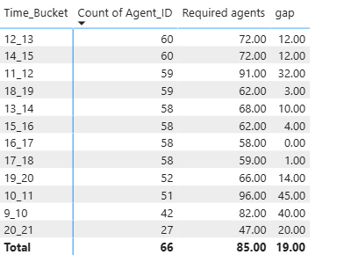
Approach and Insights
Manpower Planning – Maximum Agents Required (Assuming Current Efficiency)
If the company is satisfied with current employee performance or unable to resolve technical/routing issues immediately, the following table shows the maximum number of agents required per time bucket to reach a 10% abandon target (90% answered rate).
Calculation based on: Required Agents = ROUND( (DISTINCTCOUNT(Agent ID) (per bucket)* 90) / [Answered % per bucket], 0 ).This assumes agent productivity and call patterns remain constant across buckets.
The table represents a “maximum staffing guide,” not a hiring mandate—actual needs may reduce after resolving unassigned call issues or improving utilization.

Slide 12
Approach and Insights
Night-Time Manpower Planning – Achieving ≤10% Abandon Rate
Objective: No agents currently scheduled at night → missed calls & poor experience.
Goal: Cut abandon rate to ≤10% with smart night-time staffing.
Assumptions:
Night calls ≈ 30% of daytime volume.
Day staff: 95 agents → ~28 needed at night.
Period: 21:00–09:00, split into 2-hour buckets.
Recommendations:
Begin with ~28 agents evenly distributed across night hours.
Local ops: Focus on 21:00–00:00 and 05:00–09:00 (peak zones).
International ops: Keep steady coverage until real night-call data confirms patterns.
Next step:
Adjust staffing dynamically once hourly data is available.
efficiency.

Slide 13
Tools and Technology
Power BI
Used as the primary analytical and visualization tool for the entire project.
Performed data modeling, cleaning (via Power Query), and DAX-based calculations for KPIs such as:
Abandoned %, Answered %, Agent Efficiency, and Required Agents.
Used Power Query to transform data.
Developed insight-driven visuals highlighting system issues, agent imbalance, and staffing needs to achieve the ≤10% abandon target.
Delivered executive-level dashboards and presentations, linking technical analysis to clear business recommendations.

Slide 14

Key Findings
1️⃣ Overall Abandon Performance
Total abandon rate: 29.22 %.
Agent-level abandon: only 0.24 %, proving agents respond efficiently once a call reaches them.
Unassigned/system abandons: 28.98 % — main driver of high overall abandon rate.
2️⃣ Root Causes Identified
System / routing issues: Calls dropped before assignment (IVR timeouts, inactive IDs, mapping errors).
Uneven agent utilization: Some agents work < 4 hours/day, others > 7 hours — imbalance, not shortage.
Data quality gaps: 34 k unassigned calls and inactive agents inflating KPIs.
3️⃣ Operational Insight
The problem is not manpower, but inefficient routing and poor distribution.
Fixing these issues can reduce apparent abandon % from 29 % to nearly 10 % without new hires.

Slide 15
Conclusion
Performance Insight: Strong agent efficiency, but system coordination gaps cause most missed calls. Once connected, service is excellent — the real issue lies in unassigned calls and uneven shift coverage.
Strategic Actions:
Fix system issues first → review IVR flow, routing logic, and inactive agent mapping.
Redistribute current staff → balance workloads before considering new hires.
Add night coverage → deploy ~250 agents (≈30% of day staff) for 21:00–09:00.
Use required-agent table as a cap → reduce after system fixes.
Monitor continuously → track abandon % hourly and adjust dynamically.
Result: Data-driven manpower planning → lower abandon rate, reduced cost, and true 24×7 service reliability

Slide 16
THANK YOU

